Slide 1
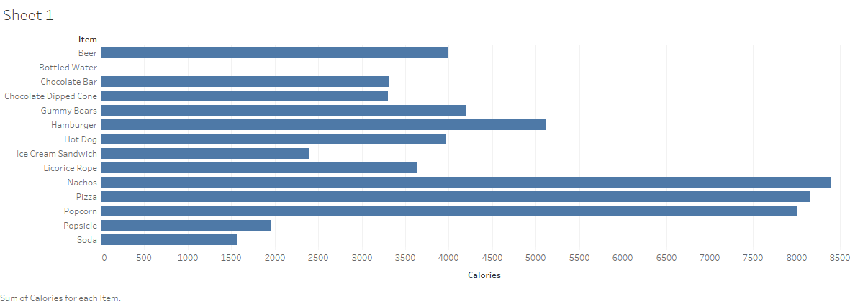

Slide 2
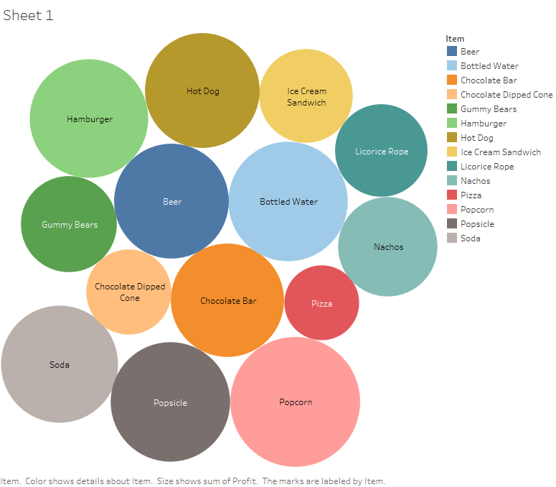

Slide 3
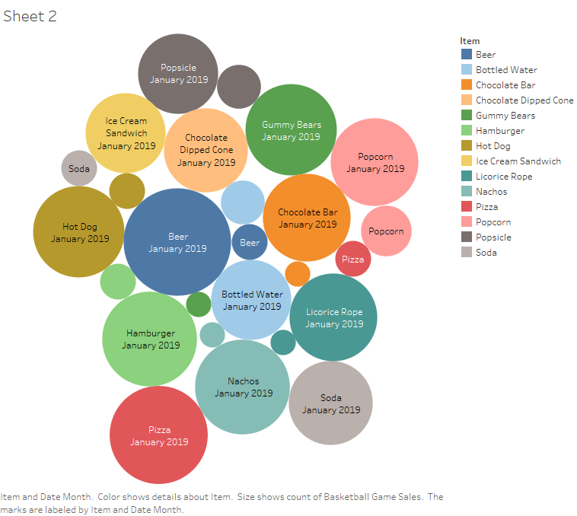

Slide 4
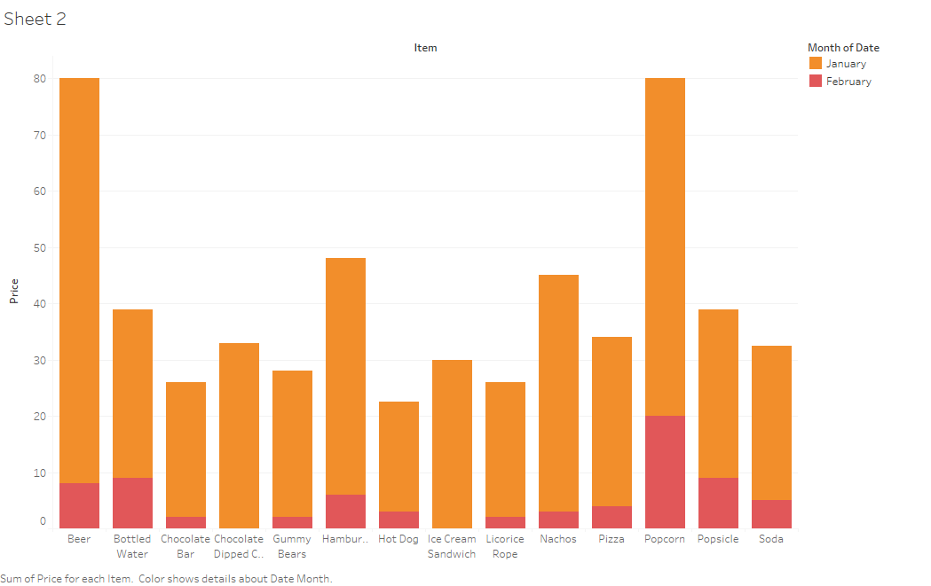

Slide 5
Narrative
For the first slide, I chose a Horizontal bars image to represent visually the sum of total calories for each item sold during the time from 1/1/2019 through 2/8/2019. This way, I could see the smallest and largest in total sum of calories for items sold during the time. For example, soda had the smallest total caloric item. On the other hand, nachos were the highest.
The Second slide shows the sum of profit and each item as a circle. I selected this image to see which item made the lowest and highest profit. Pizza had the smallest profit during the period. Many other items such as Popcorn, Popsicle, Bottled Water and more had high profits. Perhaps it is easier to see the circles that are designated, each with the item’s name, and choose the ones that are large. For example, I would concentrate less on selling pizza and instead sell more bottled water, popcorn, soda, and many other large circles, knowing that those items will generate a much higher return than pizza.
For the third image, I chose also circles but only each circle shows size in quantity for each item that was sold. The bigger the circle, the highest amount was sold by that item. Looks like beer was the leader. It is unsurprising that fans like to consume many alcoholic beverages during games.
Lastly, the bar chart was chosen for the last slide to represent the sum of the prices for each item during the time. On a monthly basis it is easy to see visually That beer and popcorn both dominated over the other items.
Please note the data shows a full month for January and only eight days for February. Even if we had a full month of data for February, it is likely that the numbers would still be lower and images smaller of minimum and maximum total number since there are only twenty-eight days in February versus thirty-one days in January 2019.

